Slide 1
Facebook Ads Inspiration Platform
A site to reference and learn from the best in class facebook ads from across the globe.

Slide 2
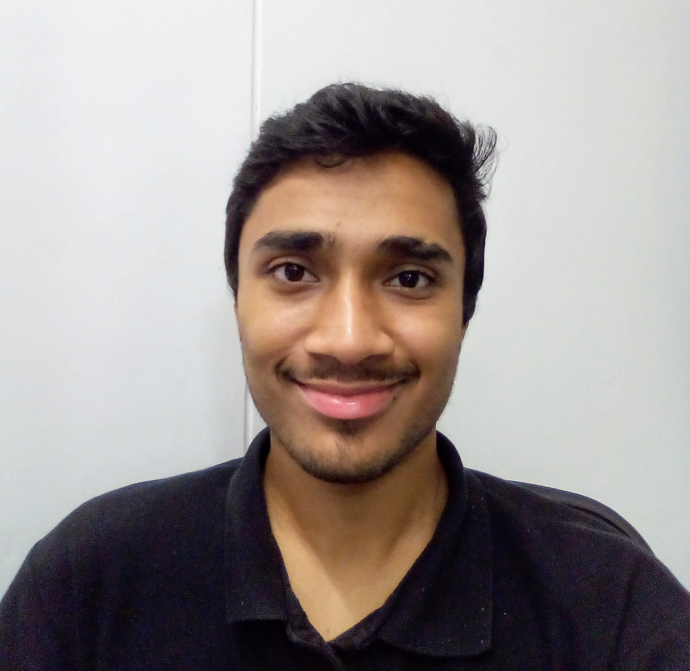
About Me
Engineer from Mumbai, India
Technical Lead at Elevar Sports (early stage startup and sports brand)
Performance marketing specialist
Managing all online ads
Love solving problems :)
Email: rohitbhaskar1vs10@gmail.com (the “1vs10” is a long story!)
Site: http://rohitbhaskar.tk/
LinkedIn: https://www.linkedin.com/in/rohitb1vs10/

Slide 3
Not so fast!
Let’s look at some numbers first

Slide 4
1.62 B
Daily Active Users on Facebook

Slide 5
$70 B
Facebook’s Ad Revenue Estimate for 2020

Slide 6
3 M
Daily Active Ads On Facebook

Slide 7
The Problem

Slide 8
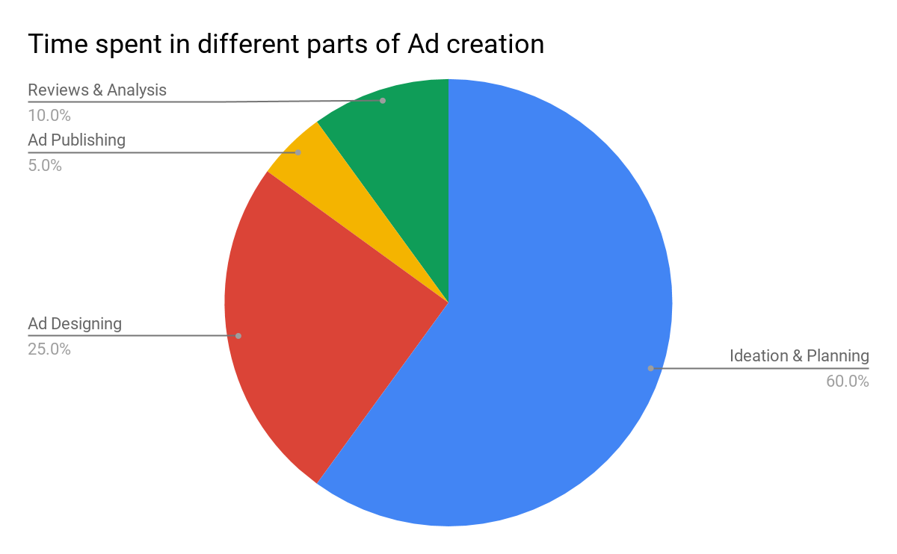
The Problem!

Slide 9
The Problem!
Huge amount of unstructured data
A lot of ideation and references required
A lot of time spent in finding the correct ad references
Past learnings not shared within or across companies
Each company/team has to learn from scratch

Slide 10
The Solution

Slide 11
An online ads repository with blazing fast, accurate neural search

Slide 12
The Solution
Create a repository of FB Ads
Repository is searchable using Jina
Search via Image, Video or Text !
Blazing fast and robust Neural Network searches
Combine with Symbolic searches (Think filters to narrow down)
And we have!!...

Slide 13
A platform that can help marketers find and learn from the best ads online

Slide 14
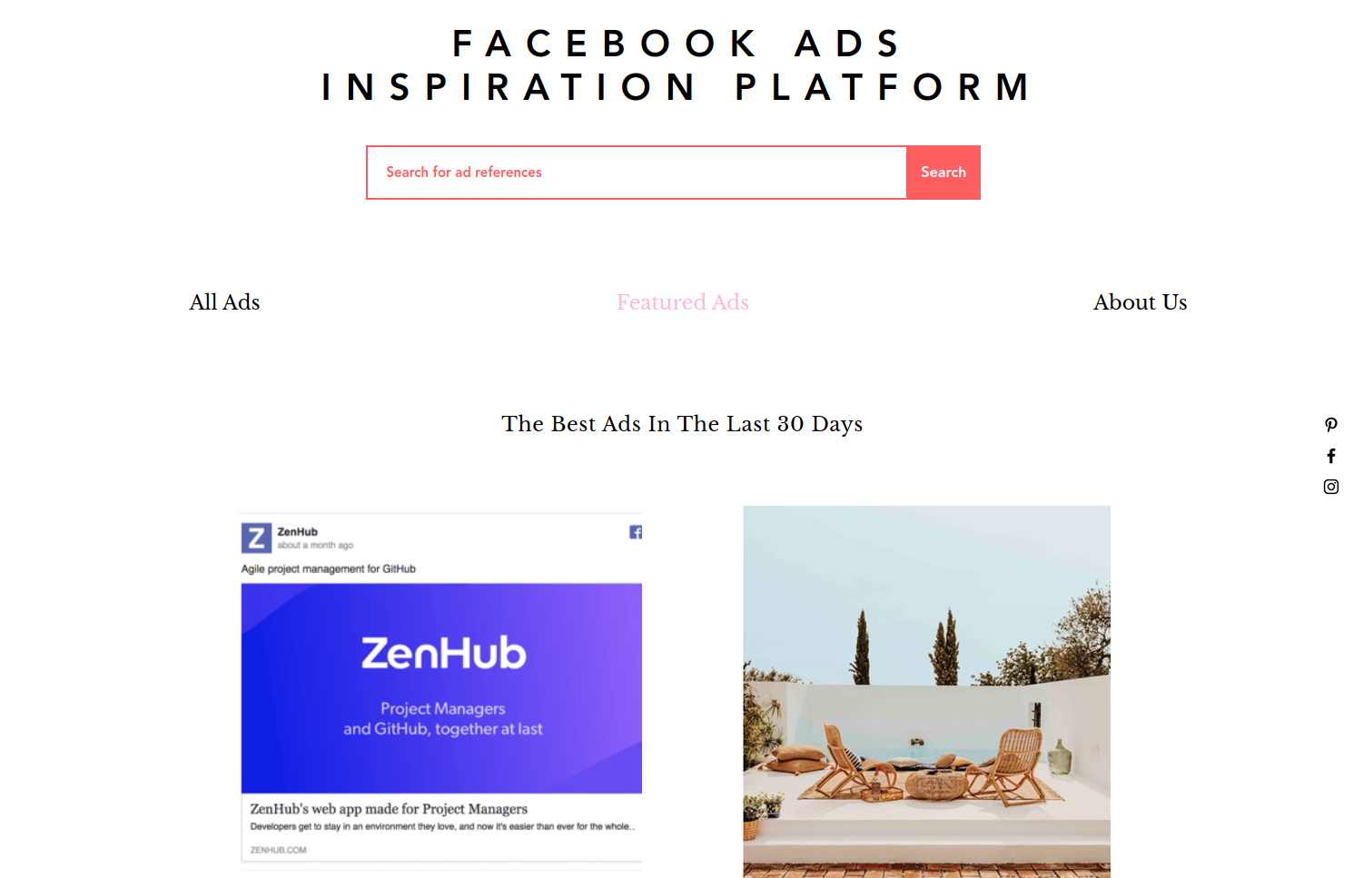
The Solution
https://rohitbhaskar1vs10.wixsite.com/fb-ads-inspirations

Slide 15
Demo

Slide 16
Demo

Slide 17
The Vision

Slide 18
Not so fast!
Let’s look at some numbers again!

Slide 19
$980 B
Expected Value Of The Online Advertising Market By 2025

Slide 20
4.41 B
Estimated Number Of People On Social Media Platforms By 2025

Slide 21
At last,
The Vision!

Slide 22
The Vision
“To be the one stop solution for all online ad references and most of the ad creation.
Across all digital media platforms”

Slide 23
The Future

Slide 24
The “Near” Future (1-2 mo)
Add capabilities for video and text search
Build out a fully functioning prototype
Build a customer facing site
Launch launch launch!!!

Slide 25
The “Distant” Future (3-6 mo)
Build and nurture a community around the product
Add references from other digital media platforms (think google ads)
Automatic media parsing and tagging
Tie-ups with freelancers to help small brands build creative content
Integration of FB and Google API’s to automatically create ads
In-depth analysis of campaign performances

Slide 26
Thank You!

